Slide 1
WELCOME.....☺️

Slide 2
INTRO✨
⭐Welcome to my portfolio presentation! ✨
⭐This project showcases my journey, creativity, and passion 👗for fashion design, blending style with digital technology 💻to inspire and share new ideas.✨
⭐“I’m a BCA student with a dream to shine as a fashion designer, blending creativity with passion. My journey is about turning imagination into timeless style✨”

Slide 3
DIGITAL PORTFOLIO ✨
STUDENT NAME. : S.RAGAVI
REGISTER NO AND NMID: astvu30430424u09019
951548
DEPARTMENT. : BCA
COLLEGE/UNIVERSITY. :Arignar Anna Govt.Arts Collage/
Thiruvalluvar University

Slide 4
PROJECT TITTLE ✨
🌈Fashion Designer 👗 Digital portfolio 👤Using Front End Development...💦✨
♥️

Slide 5
AGENDA ✨
1.Problem Statement
2.Project Overview
3.End Users
4.Tools and Technologies 5.Portfolio design and Layout
6. Features and Functionality 7.Results and Screenshots 8.Conclusion
9.Github Link

Slide 6
PROBLEM STATEMENT ✨
⭐In today’s digital era, traditional resumes alone are not enough to showcase skills and projects effectively. ⭐Many students and professionals lack a structured online presence to highlight their work. ⭐A digital portfolio provides an interactive and accessible platform to present achievements, skills, and experiences.

Slide 7
PROJECT OVERVIEW ✨
⭐This project is a digital portfolio website built using HTML, CSS, and JavaScript. ⭐It includes key sections like About Me, Projects, Skills, and Contact. ⭐The main purpose is to showcase personal achievements, technical skills, and creative projects. ⭐The design is responsive and interactive, ensuring a smooth user experience. ⭐This portfolio acts as a professional identity to connect with recruiters, clients, and peers.

Slide 8
WHO ARE THE END USERS? ✨
1. Student✨– Can use the portfolio to share their academic projects and resumes. 2. Job Seekers ✨– Can present themselves professionally to recruiters. 3.Freelancers ✨– Can showcase their work and skills to potential clients. 4.professionals ✨– Can highlight their experience and achievements.

Slide 9
TOOLS AND TECHNIQUES ✨
🛠️ TOOLS:
⭐HTML – Structure of the website
⭐CSS – Styling & designer
⭐JavaScript – Interactivity (menu, form, slider)
⭐VSCode / Sublime – Coding editor
⭐Browser – Testing output
⭐Git / GitHub – Version control & sharing

Slide 10
⚡ TECHNIQUES:
⭐Clean & structured coding
⭐Redponsive design (mobile + desktop)
⭐Reusable components (header, footer, buttons)
⭐Testing & debugging for smooth performance

Slide 11
PORTFOLIO DESIGN AND LAYOUT ✨
Header/Navber
⬇️
Hero Section (Name+intro)
⬇️
About Section (profile image+Bio)
⬇️
Skills & Achievements (cards+progress Bards)
⬇️
Collections/Projects(Slider+Grid)
⬇️
Design process (That steps)
⬇️
Contact Section (From)
⬇️
Footer(Copyright+Social Links)
📊 Portfolio
Layout
📊 Portfolio Layout

Slide 12
🎨 Design Highlights✨
⭐Simple & Elegant Colors – Blue gradient + white background.
⭐Consistent Fonts – Clear readability.
⭐Interactive Effects – Hover animations & smooth scrolling.
⭐Responsive – Mobile, Tablet, Desktop friendly.

Slide 13
FEATURES AND FUNCTIONALITY ✨
⭐ Navigation bar with smooth scrolling
⭐Hero Section
⭐ About ,skills, project, Achievements sections and extra...
⭐Slider for collections
⭐Project showcase with images/details
⭐ Interactive elements (hover effects, animations)
⭐ Contact form (with validation)
⭐Responsive design for all devices
⭐Links to social profile

Slide 14
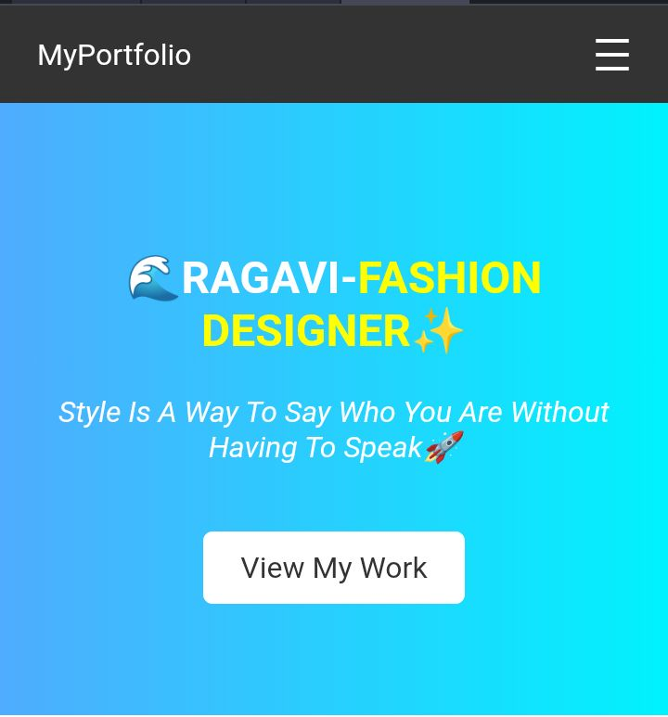
RESULTS AND SCREENSHOTS ✨
🌈screenshot of HTML,CSS and JAVA page Result✨

Slide 15
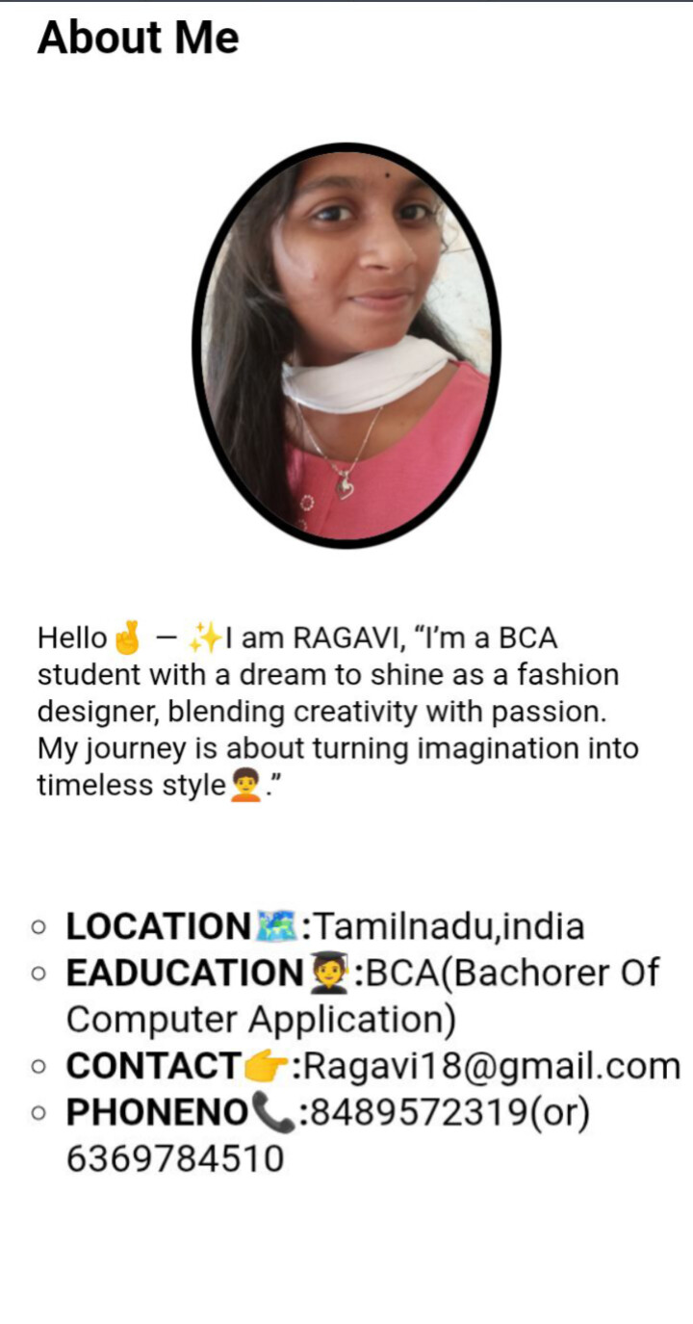
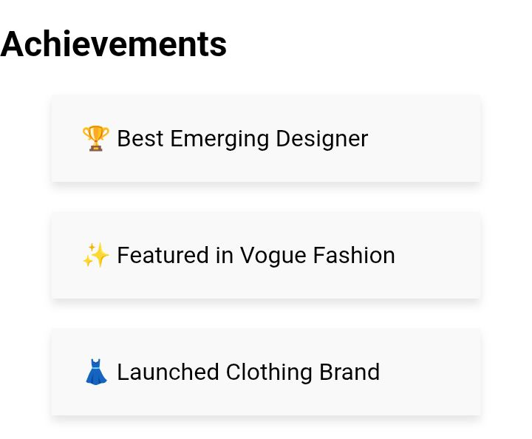

Slide 16
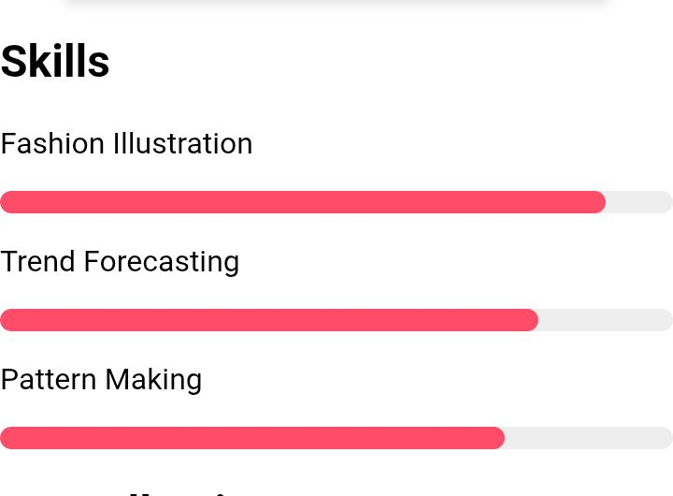
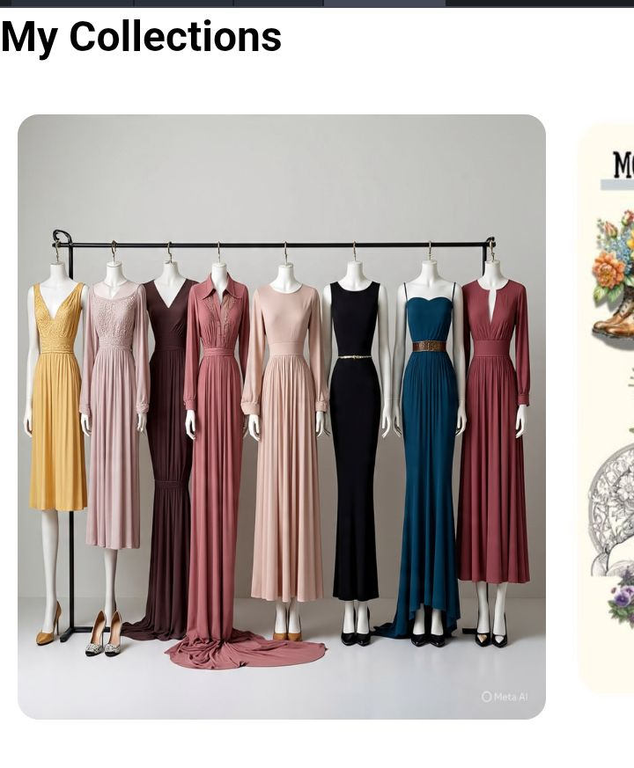

Slide 17
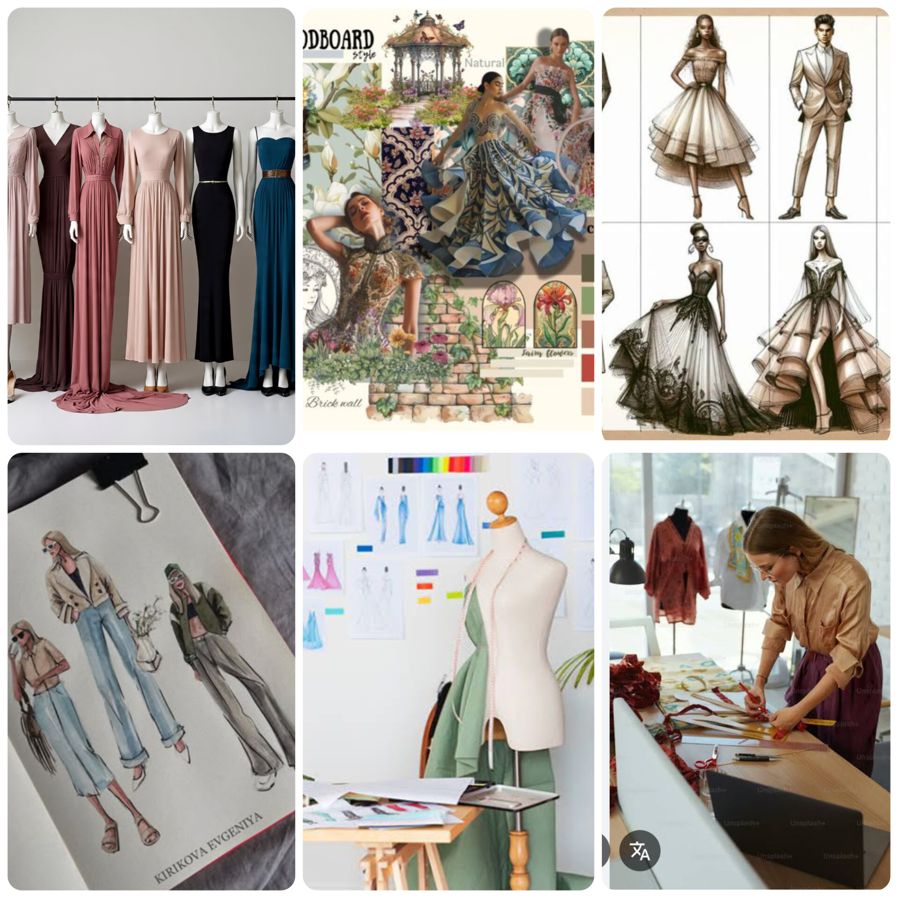
⚡MY COLLECTIONS....✨

Slide 18
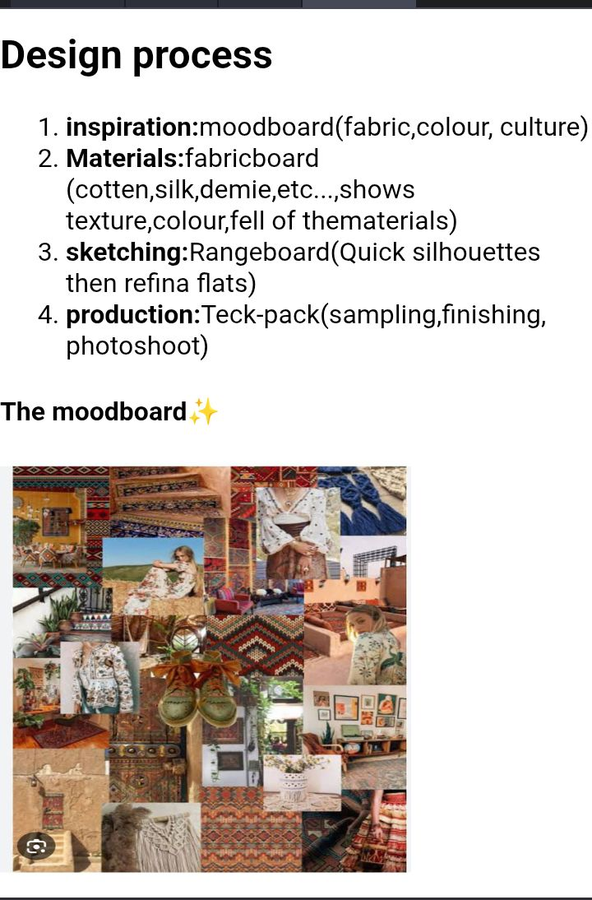
They are four steps:
⭐The moodboard
⭐The fabric board
⭐The Range board
⭐The teck-pack

Slide 19
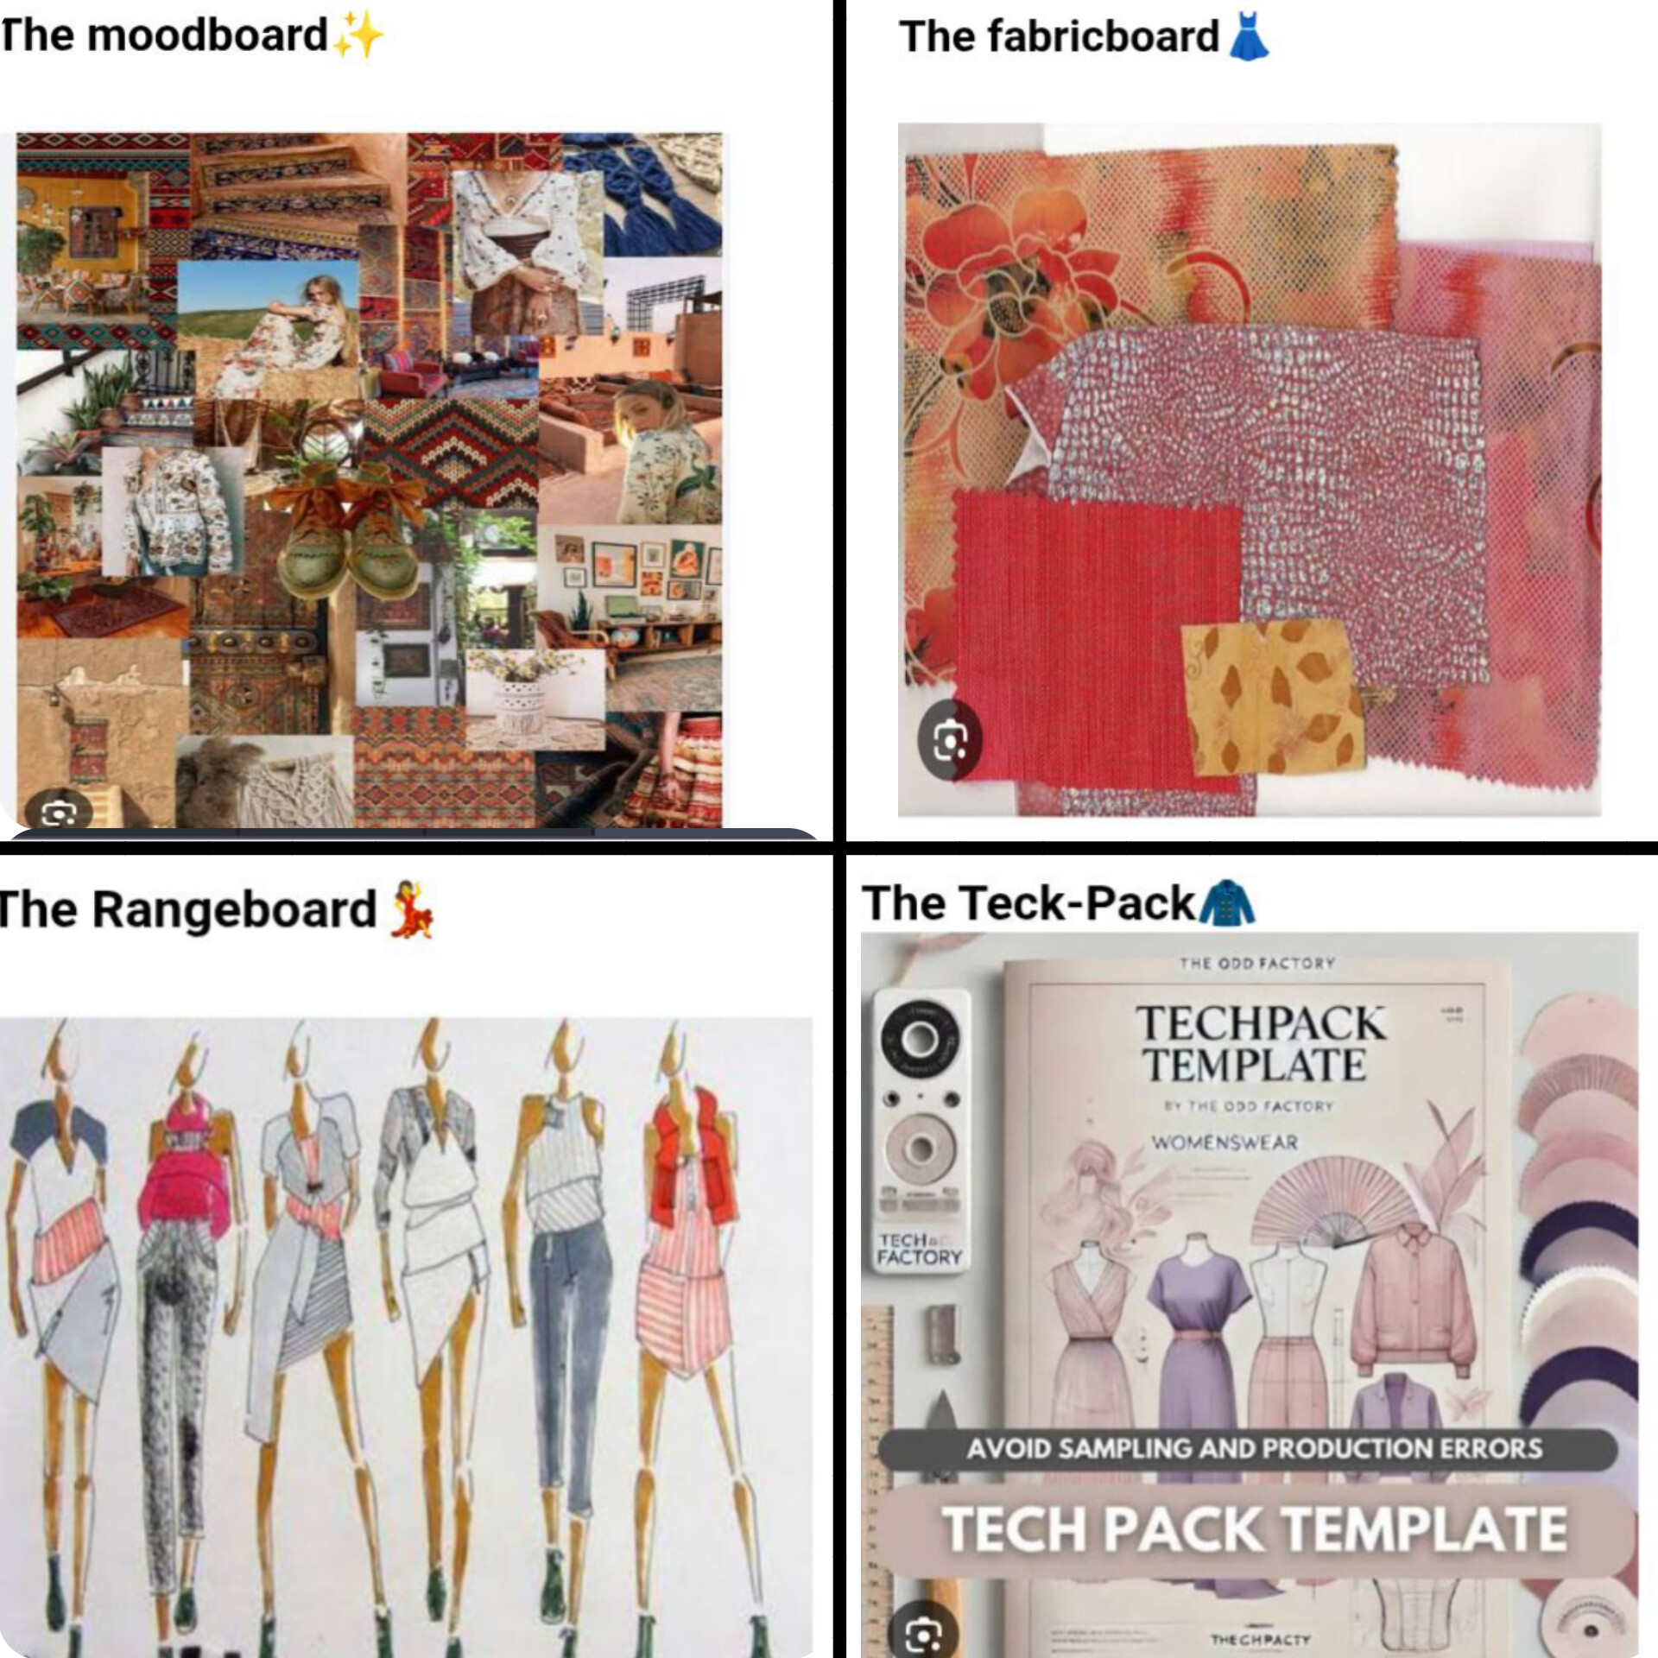
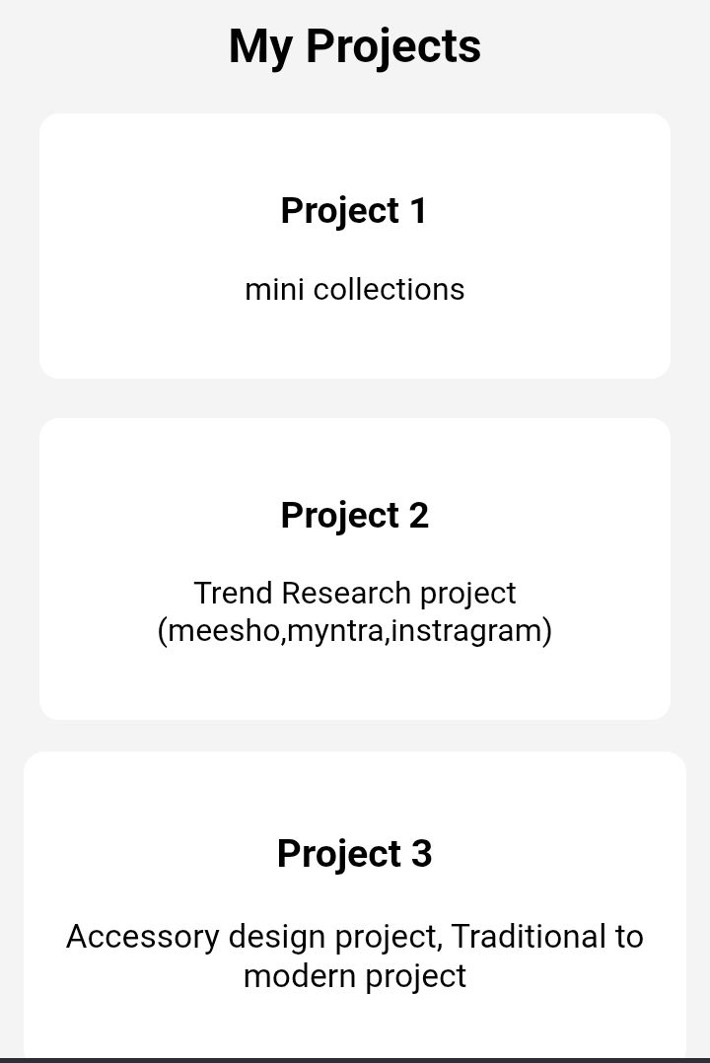

Slide 20
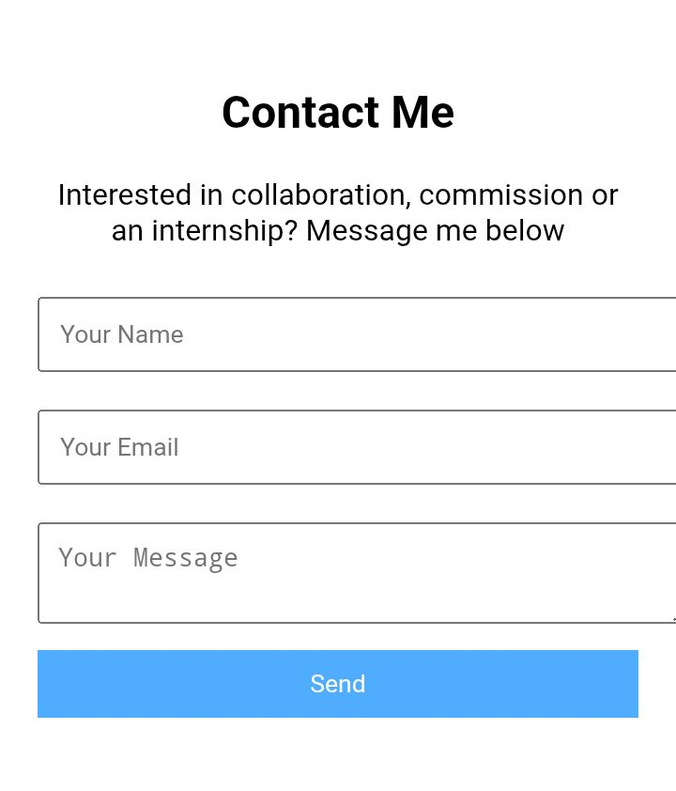
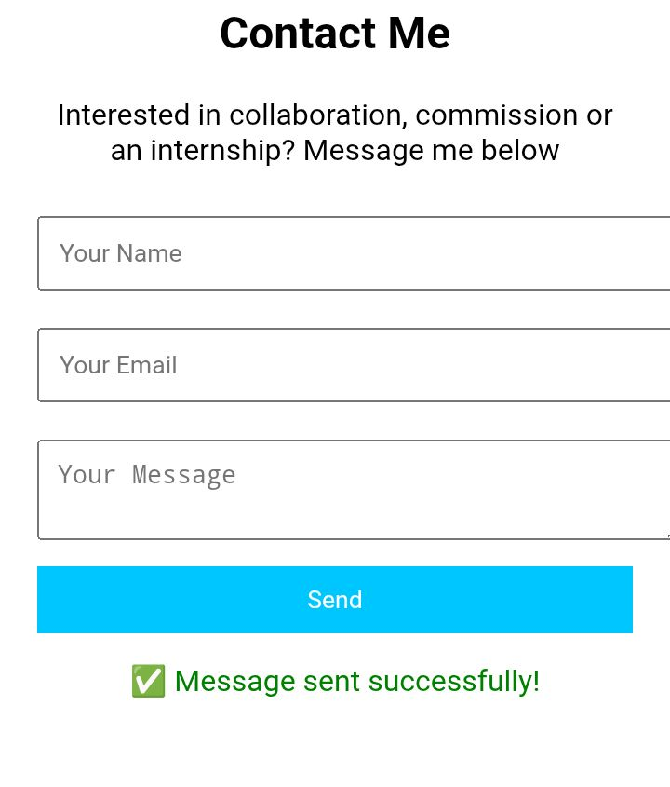
Before contact ✨
After contact ✨

Slide 21
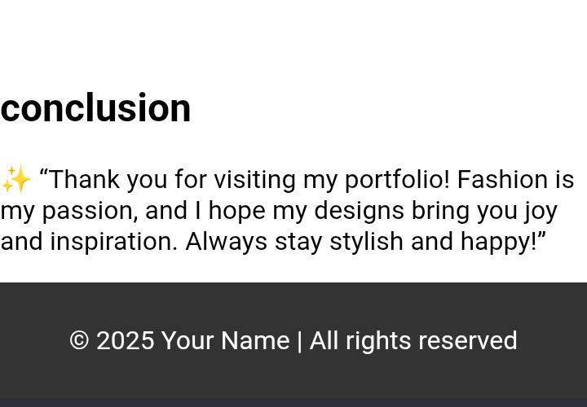
Finishing of screenshots ✨

Slide 22
CONCLUSION ✨
⭐This portfolio showcases my creativity, skills, and passion for fashion design, supported by web technologies like HTML, CSS, and JavaScript. It brings together design collections, process, achievements, and projects in a professional way.
HIGHLIGHTS OF THE PROJECT👗
FAINAL SUMMARY ✨
⭐The project reflects how technology and fashion can collaborate. It not only serves as my personal portfolio but also demonstrates the importance of digital platforms in presenting ideas to the world.

Slide 23
BENEFITS OF SCOCITY🌏
⭐By sharing designs digitally.🧥
⭐it inspires others in the field of fashion.👤
⭐ encourages sustainable creativity.❄️🌸
⭐motivates students to explore the combination of technology and art for a better future.🧚🧚
⭐Preserves culture and tradition 👘
⭐Creates job opportunities 👩‍🎨👗
⭐Supports economy and local businesses 💰
⭐Promotes eco-friendly and sustainable fashion 🌿
⭐Inspires creativity and confidence ✨
"FASHION IS MY PASSION"

Slide 24
GITHUB LINK ✨
https://github.com/ragaviragavi182007-beep/TNSDC-FWD-DigitalPortfolio.git

Slide 25
THANKYOU.....✨♥️

